Slide 1
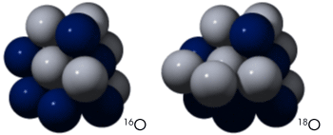
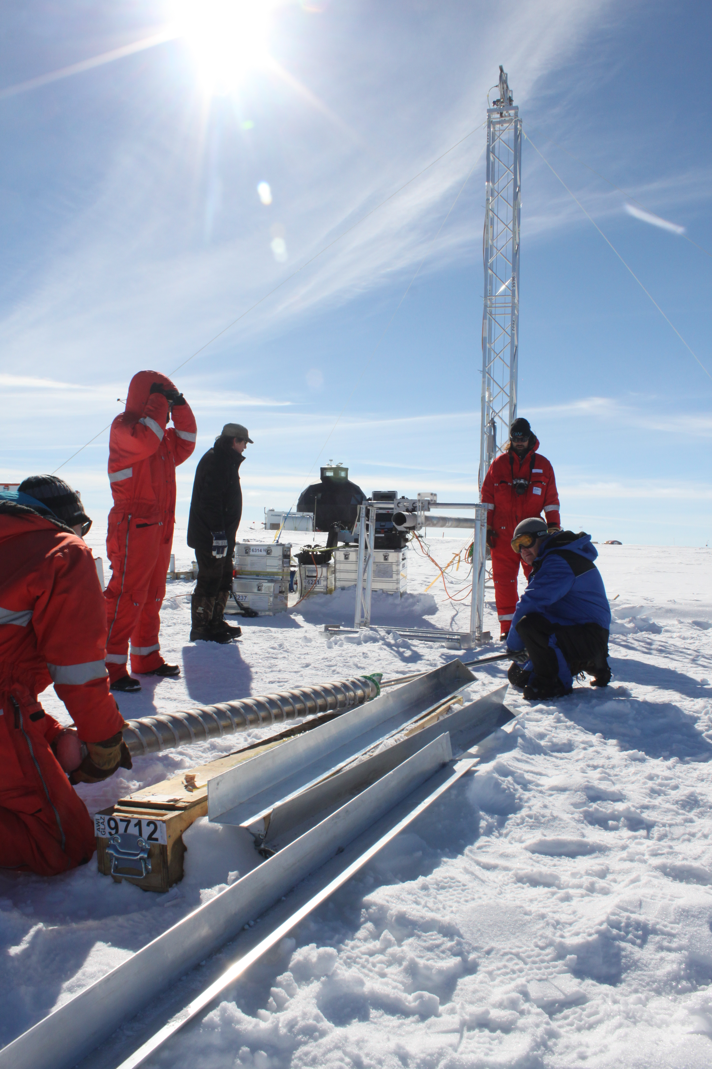
Climate change on a Geological time scale
Courtesy Robert Simmon, NASA
Isotopes in ice cores from polar regions tell the story of climate change on a Geological time scale
By Steven Neshyba and Emma Sevier, with edits by Penny Rowe
Ice core researchers in Greenland. Photo by Helle Astrid Kjær / CC BY (https://creativecommons.org/licenses/by/4.0).
Notes:
The image at left shows Ice core researchers from AWI drilling at the EastGRIP ice core site Greenland

Slide 2
Isotopes
Difference from normal abundance is called
δ¹⁸O
¹⁸O-depleted samples have negative δ¹⁸O
¹⁸O-rich samples have positive δ¹⁸O
Normal abundance is ~99.8%
Normal abundance is ~0.2%
Courtesy Robert Simmon, NASA

Slide 3
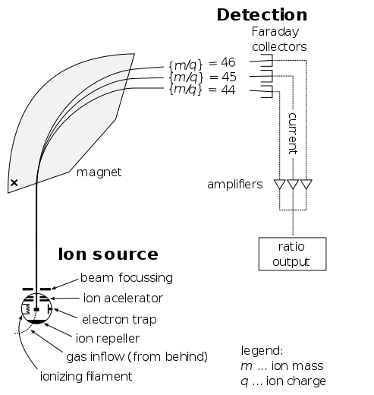
Mass spectrometers measure isotope composition very precisely
Schematic of a typical mass spectrometer
Courtesy of Devon Fyson

Slide 4
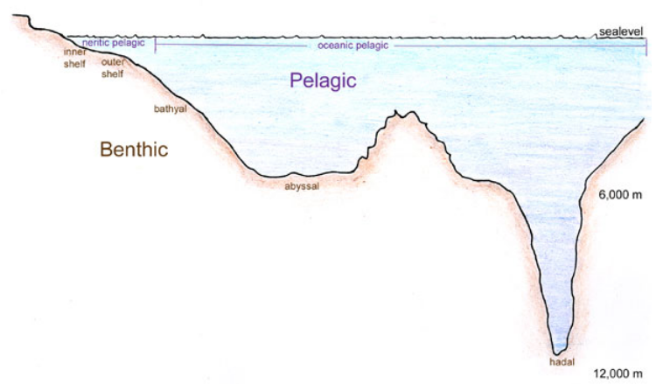
of water in the air and in the oceans
Water vapor in air above the oceans is a little ¹⁸O-depleted compared to normal
Water left behind in the oceans is a little ¹⁸O-rich compared to normal
Can you guess why?
Think about throwing a heavy ball into the air vs a light ball.
So, is δ¹⁸O in the air positive or negative?
Picture Courtesy of Genevieve Anderson

Slide 5
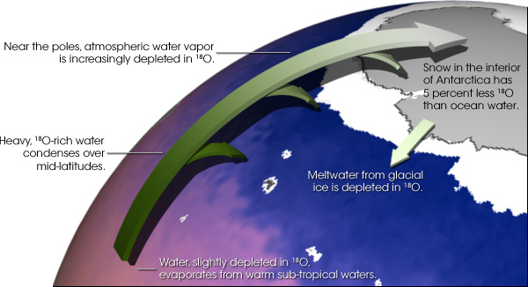
–depleted water in the air eventually falls as snow
¹⁸O in snow falling onto the Antarctic ice sheet is depleted compared to normal. The exact amount depends on where exactly you are in the Antarctic, but it ranges from 3 to 5%. A 3% depletion corresponds to δ¹⁸O = -30 ppt.
Cool fact: when the global temperatures are lower (like during an ice age), δ¹⁸O gets even more negative.
So, oxygen isotopes in ice cores act like a kind of thermometer.
Courtesy Robert Simmon, NASA

Slide 6
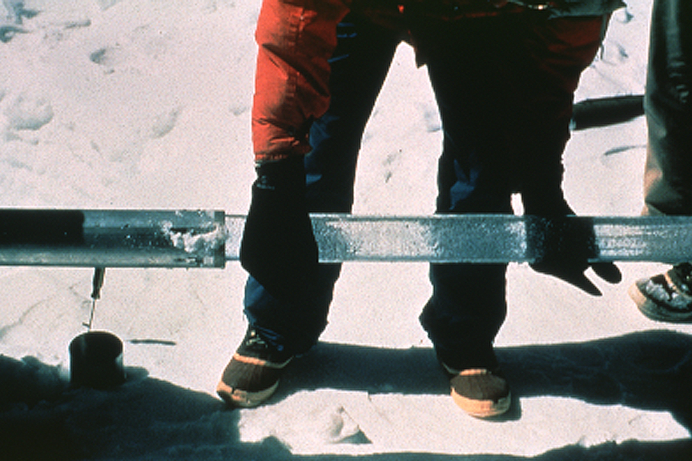
as a thermometer of past climates
Courtesy
Lonnie Thompson

Slide 7
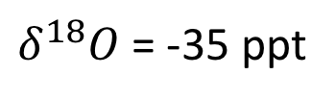
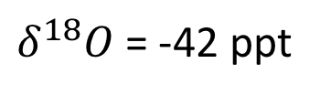
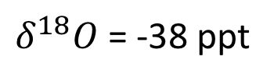
as a thermometer of past climates
Surface
$δ^{18}O$ = -35 ppt
Which is the oldest sample?
At which time (depth) was the climate coldest?
1000 meters deep
$δ^{18}O$ = -42 ppt
2000 meters deep
$δ^{18}O$ = -38 ppt

Slide 8
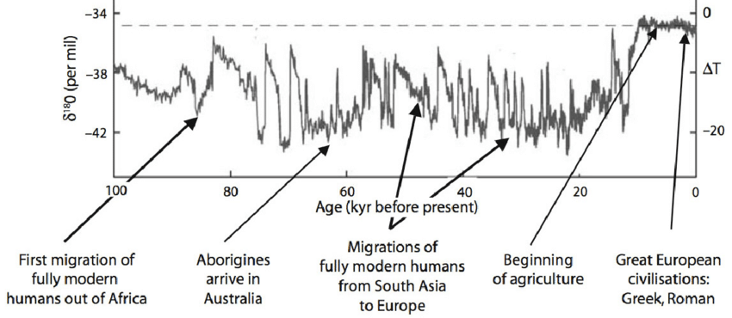

Climate and humans over the last 100 kyr
$$∆T$$
1 kyr = 1000 years
Can you identify important human events around these times?
Notes:
https://www.researchgate.net/publication/280316525_Chapter_20_Extreme_weather_and_resilience_of_the_global_food_system/figures?lo=1

Slide 9
Climate and humans over the last 100 kyr
Notes:
https://www.researchgate.net/publication/280316525_Chapter_20_Extreme_weather_and_resilience_of_the_global_food_system/figures?lo=1

Slide 10
Dansgaard-Oeschner cycles
Increases in temperature sometimes happened pretty quickly … at the start of DO cycles
Notes:
https://www.researchgate.net/publication/280316525_Chapter_20_Extreme_weather_and_resilience_of_the_global_food_system/figures?lo=1

Slide 11
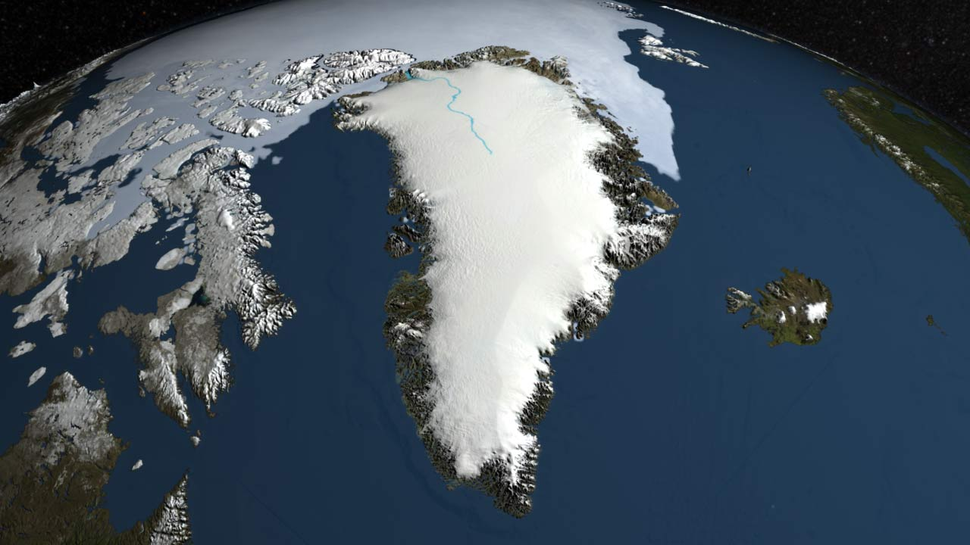
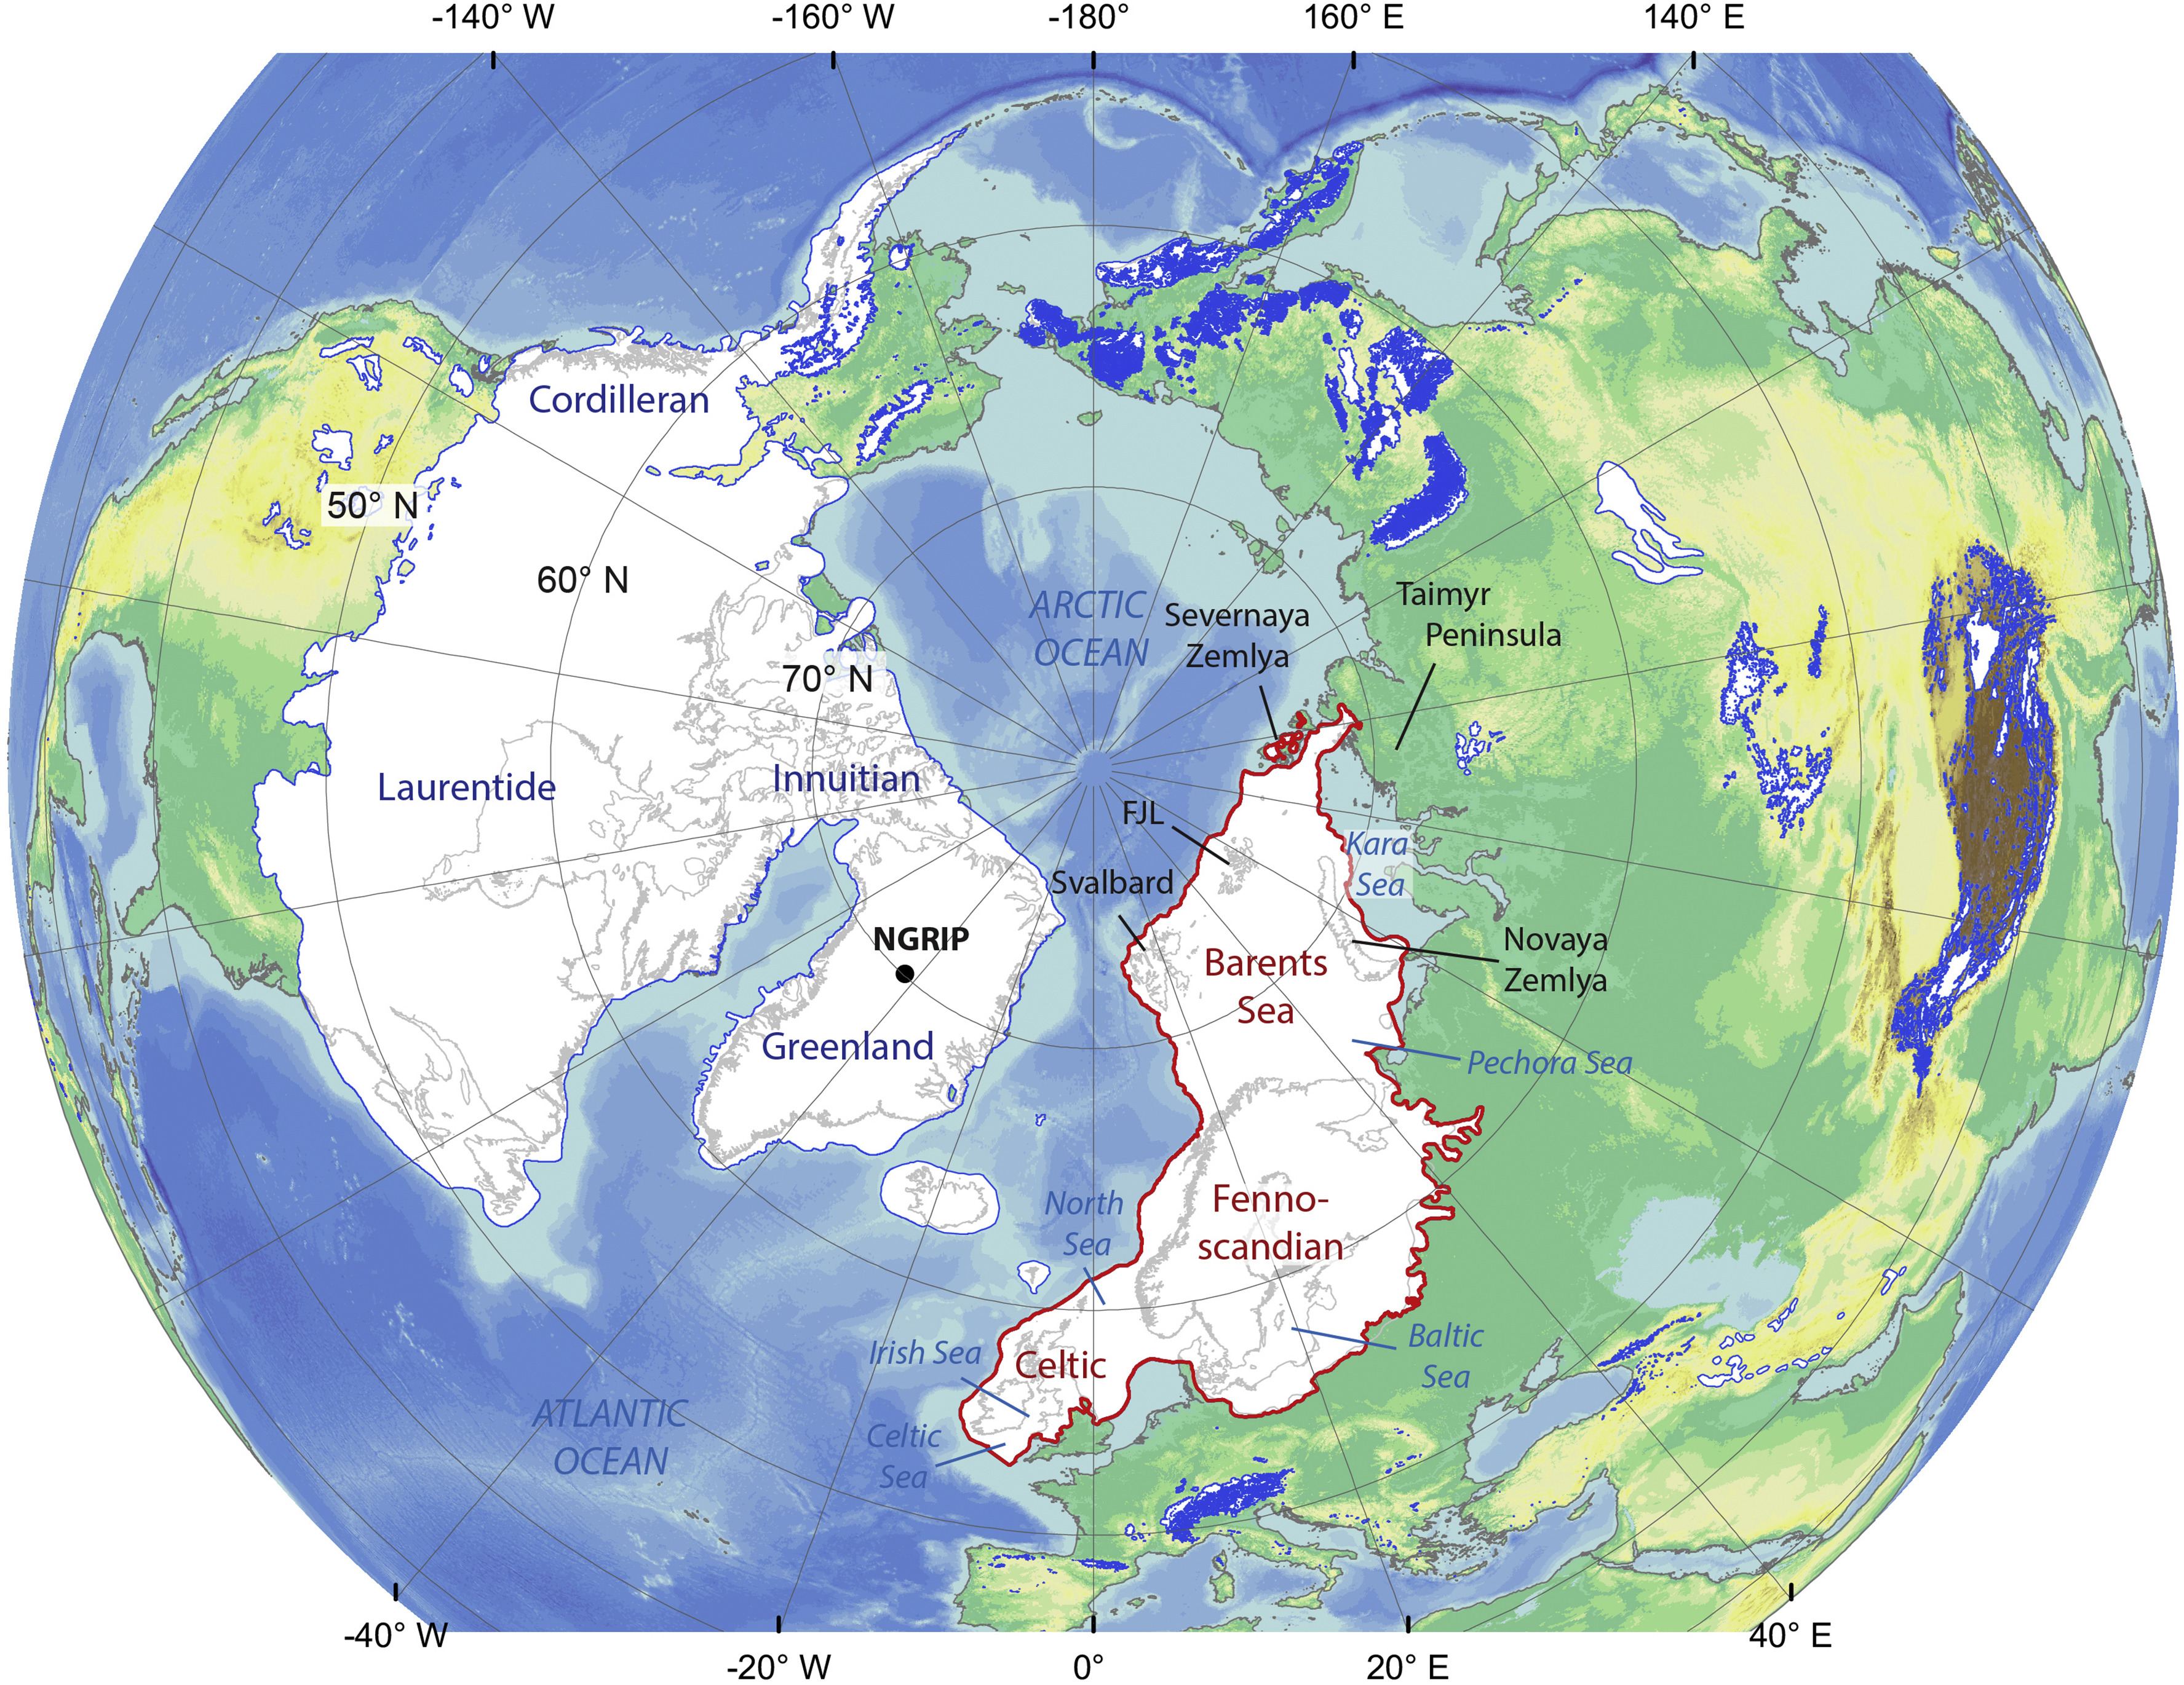
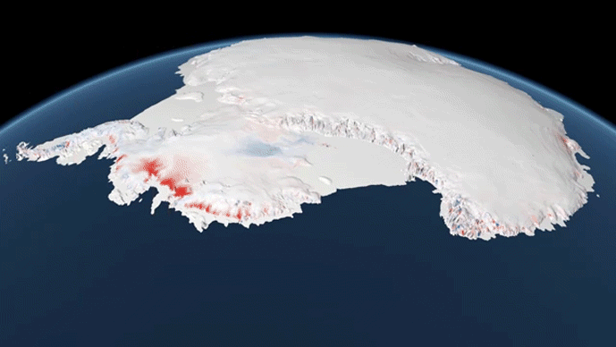
The “Last Glacial Maximum” Great ice sheets of 20,000 years ago
Greenland
North American and Eurasian ice sheets
Courtesy NASA visualization
Antarctica
Courtesy Henry Patton
Courtesy Philip Eales, Planetary Visions
Notes:
Patton, H., Hubbard, A., Andreassen, K., Winsborrow, M., Stroeven, A.P., 2016. The build-up, configuration, and dynamical sensitivity of the Eurasian ice-sheet complex to Late Weichselian climatic and oceanic forcing. Quaternary Science Reviews 153, 97–121.https://doi.org/10.1016/j.quascirev.2016.10.009

Slide 12
Lots of melting in the last 20,000 years
Greenland
North American and Eurasian ice sheets
Courtesy NASA
Courtesy NASA visualization
Antarctica
Courtesy NASA
Courtesy Henry Patton
Courtesy Philip Eales, Planetary Visions

Slide 13
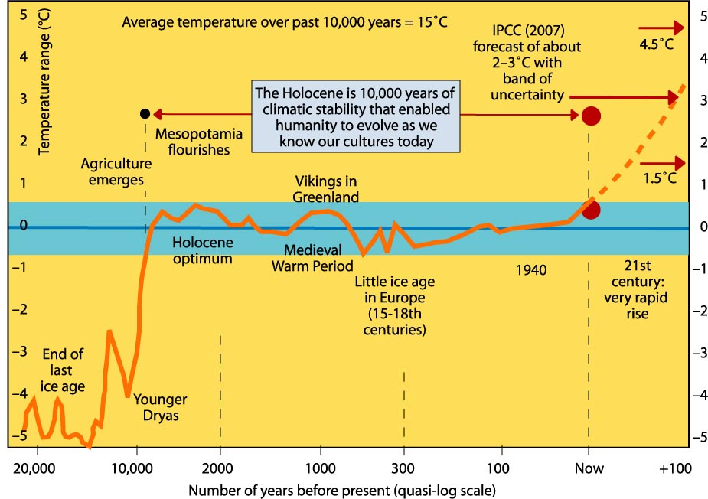
Climate has remained pretty steady in the last 10,000 years
Image courtesy Robert Corell
Notes:
http://www.climatecodered.org/2011/01/rethinking-safe-climate-have-we-already.html

Slide 14
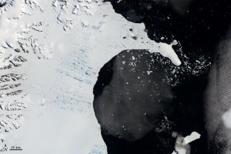
Disintegration of Larsen B in 2002
January 31, 2002
March 5, 2002
Courtesy NASA
Courtesy NASA

Slide 15
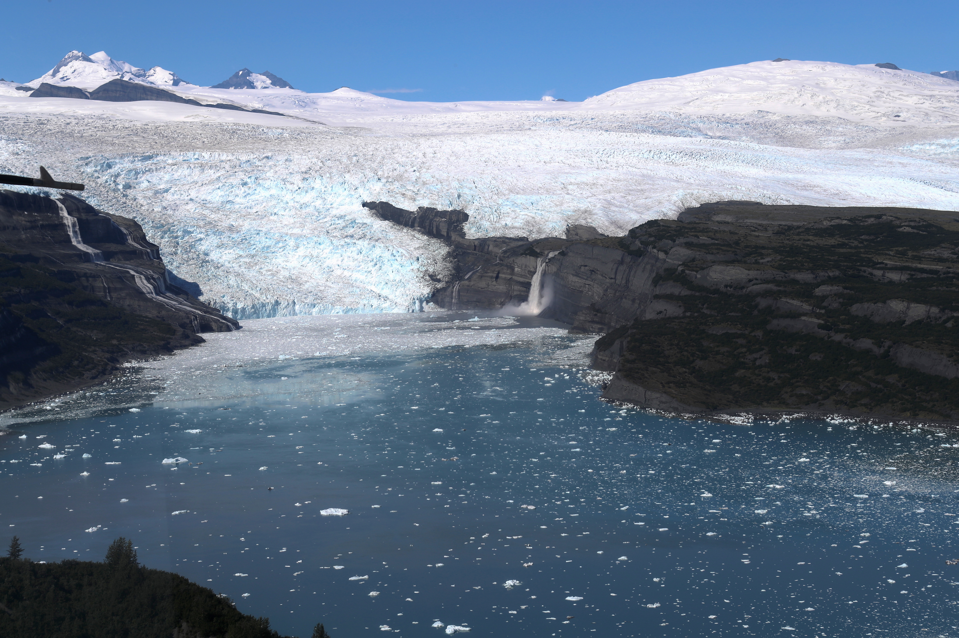
What are the prospects for future sea level rise?
Antarctica: 58 meters sea level equivalent (SLE)
Greenland: 7.4 m
53.3 meters
4.5
Courtesy NASA
Courtesy NASA
SLE estimates from Davies, 2019
Mountain glaciers:
0.4 m (40 cm)
Courtesy NASA

Slide 16
What caused all these changes?
Partial answer: Orbital variations changed the amount of sunlight to land on the earth
Notes:
https://www.researchgate.net/publication/280316525_Chapter_20_Extreme_weather_and_resilience_of_the_global_food_system/figures?lo=1

Slide 17
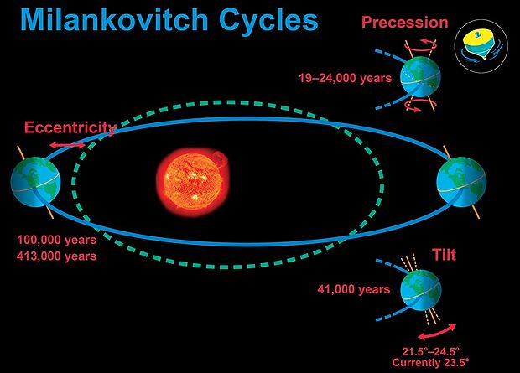
Milankovitch cycles
Milankovitch cycles change how much sunlight reaches the earth, hence can drive glaciation/deglaciation cycles.
DO events occur on a smaller time scale (a few thousand years), so we can’t attribute them to Milankovitch. But we can see Milankovitch fingerprints on longer time scales in the ice core data.
The catch: Milankovitch-related changes in solar energy weren’t big enough on their own … they needed some kind of climate amplifier (like CO₂)
Courtesy UCAR

Slide 18
What we learned
Isotopes of oxygen in ice cores are a temperature proxy (record).
Significant human migrations resulted as a result of rapid changes in temperature (and sea level) associated with Dansgaard-Oeschner cycles.
On longer time scales, Milankovitch cycles can explain the timing of glaciation/deglaciation.
Both Dansgaard-Oeschner and Milankovitch cycles require some kind of climate amplifier (like CO₂) to explain their effect on climate.

Slide 19
References
Isotopes: Simmon, Robert, NASA, https://earthobservatory.nasa.gov/features/Paleoclimatology_OxygenBalance
Mass Spectrometer: Fyson, Devon, https://commons.wikimedia.org/wiki/File:Mass_Spectrometer_Schematic.svg
Ocean profile: Anderson, Genevieve, SBCC, https://www.marinebio.net/marinescience/01intro/woclass.htm
18O map: Simmon, Robert, NASA, https://earthobservatory.nasa.gov/features/Paleoclimatology_OxygenBalance
Ice core: Thompson, Lonnie, http://www.antarcticglaciers.org/glaciers-and-climate/ice-cores/ice-core-basics/#jp-carousel-5901
100 kyr timeline: Steffen, Will. Notes: (i) the estimates of human migration patterns (dates etc.) come from a wide variety of sources on human migration out of Africa, and (ii) the actual timeline of temperature changes comes from the GRIP (Greenland) ice core, as published in: Ganopolski A and Rahmstorf S (2001) Rapid changes of glacial climate simulated in a coupled climate model. Nature 409: 153-158.
North American and Eurasian ice sheets: Patton, H., Hubbard, A., Andreassen, K., Winsborrow, M., Stroeven, A.P., 2016. The build-up, configuration, and dynamical sensitivity of the Eurasian ice-sheet complex to Late Weichselian climatic and oceanic forcing. Quaternary Science Reviews 153, 97–121. https://doi.org/10.1016/j.quascirev.2016.10.009
Greenland: NASA Visualization, https://www.astrobio.net/also-in-news/greenland-ice-sheet-vulnerable-climate-change-previously-thought/
Antarctica: Eales, Philip, Planetary Visions, https://climate.nasa.gov/news/2749/ramp-up-in-antarctic-ice-loss-speeds-sea-level-rise/
Corell, Robert, http://www.climatecodered.org/2011/01/rethinking-safe-climate-have-we-already.html
Larsen B: NASA, https://www.livescience.com/42562-antarctic-ice-shelf-collapse-cause.html
Sea Level Equivalents: Davies, Bethan, 2019, http://www.antarcticglaciers.org/glaciers-and-climate/what-is-the-global-volume-of-land-ice-and-how-is-it-changing/
Mountain Glaciers: NASA, https://www.nasa.gov/feature/goddard/2019/a-decade-of-icebridge-alaska-flights
Milankovitch cycles, UCAR, https://www.universetoday.com/39012/milankovitch-cycle/

Slide 20


Acknowledgements
This Polar ENgagement through GUided INquiry (PENGUIN) module was created with funding from the National Science Foundation. Creative Commons Copyright.
You may freely use and share with attribution to the PENGUIN project as follows:
Rowe, P.M. et al (2020): Integrating polar research into undergraduate curricula using computational guided inquiry, Journal of Geoscience Education, https://doi.org/10.1080/10899995.2020.1768004.

Slide 21
Check out other PENGUIN modules
Processing Images of Arctic Ice: Explore image processing of polar satellite images.
Ice Cores and Climate Change: Work with data from ice cores from the East Antarctic Ice Sheet and Greenland, to explore earth's past climate and glacial cycles.
Heat flux through Permafrost: Learn what permafrost is and how it is impacted by climate change, and calculate heat flux through permafrost.
Polar spectra and Quantum Mechanics: Learn about the greenhouse effect by examining infrared emission spectra of the polar atmosphere.
Thermodynamics of Arctic Ice melt: Explore Arctic sea ice extent and calculate the amount of heat required to melt Arctic sea ice

